Slide 1

Afghanistan Organization Women Arise
Digital Security Training Curriculum
for Afghan Communities
Kabul, Afghanistan 2025

Slide 2
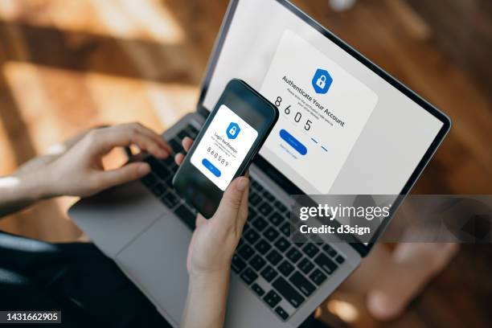
What is Computer and Mobile Security
refers to the tools, practices, and technologies used to keep your devices—like laptops, desktops, smartphones, and tablets—safe from digital threats. These threats can include viruses, malware, hackers, data theft, and more.

Slide 3
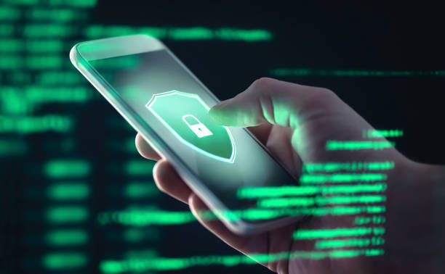
The “top 10” basics of computer and mobile protection
This section provides the “top 10” tips for improving digital security. These basic steps offer entry points for the main topics covered in greater detail in later chapters.

Slide 4
TIP 1: Update the operating system, hardware, applications, phone and software regularly
Companies provide periodic updates of their operating systems and applications to address security gaps. Updating regularly greatly improves a user’s protection against security breaches. In Windows 11, the user determines when and how to obtain the latest updates to keep devices running smoothly and securely. To manage options and view available updates, select Check for Windows Updates. Or select Start > Settings > Windows Update. • On a Mac, follow the instructions available here. • To update an Android phone, follow the instructions available here. • To update iOS (iPhone), go to the App Store and follow the instructions available here. Whichever operating system, applications and software are used, make it a priority to update regularly

Slide 5

TIP 2: Create strong passwords on all devices
Users should make sure all passwords are: • Long (more than 12 characters) • Complex (containing a mix of uppercase and lowercase letters, numbers and symbols) • Random, not containing common or personal words, number series, etc. • Unique (a separate password for each account) • Confidential (not easy to find on papers or devices)

Slide 6
TIP 3: Use multifactor authentication whenever possible
• Multifactor authentication dramatically increases digital security. • Applications specifically designed for multifactor authentication, such as Duo Mobile, Aegis Authenticator and Google Authenticator, are more secure than SMS message authentication

Slide 7
TIP 4: Install endpoint detection and response (EDR) (anti-malware) software
• Malicious software can destroy a device, steal personal information or financial assets, or control a device remotely. • EDR software provides protection from malware on the Internet. • Install licensed versions of EDR software on every device running Windows, Mac, Linux, iOS or Android. Do not use “cracked software”. • It is important to use free software only from trusted sources. Install programmes such as Malwarebytes and Avira.

Slide 8
TIP 5: Use a safe browser
• A browser acts as a window to the Internet. If the window is not secure, access and navigation are unsafe, and may be a path to infection from malicious software. • Many browsers are commercial tools for collecting information, data tracking and targeting for marketing purposes. • Use safe browsers, such as Firefox, Brave, Firefox Focus, Ghostery Dawn and DuckDuckGo, and regularly update browser software. • Check the security of add-ons/browser extensions before adding them to the browser.

Slide 9
TIP 6: Install a VPN
• A VPN protects the user’s Internet connection and privacy online by creating an encrypted tunnel for the user’s data and hiding the user’s IP address. It allows safe use of public Wi-Fi. Without a VPN for protection, devices and their locations may be tracked and data intercepted. • Choose a VPN carefully. There are free and paid services that contain malicious software, sell users’ information to a third party or cooperate with governments to provide them with users’ information. • VPNs considered safe at the time of publication include Psiphon, TunnalBear and Riseup VPN.

Slide 10
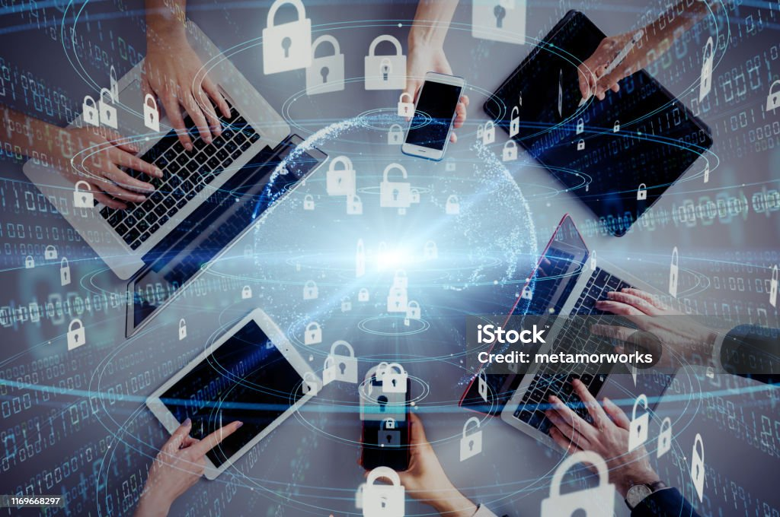
TIP 7: Use safe open-source software and applications
• Open-source software and applications are generally more secure than proprietary programmes because they provide their source code to users. This source code is then constantly updated to address security vulnerabilities. • Using open-source software and applications keeps users from installing pirated or “cracked” proprietary software without a license. Pirated or “cracked” programmes may contain malicious elements that harm devices and should never be used. • Be aware that not all open-source programmes are secure; always follow the advice of digital security experts before installing new software or applications. It is best to use programmes that have a strong track record, and to clearly understand security programmes and policies regarding privacy

Slide 11
TIP 8: Only download apps and software from recognized app stores
• Unrecognized app stores contain dozens of applications and programmes contaminated with malicious software and back doors that provide the creator with the ability to manage and control devices. • Only use recognized app stores and official application websites for downloads, such as: Google Play, the Amazon Appstore and the Apple App Store.

Slide 12
TIP 9: Encrypt computers and phones
• Encryption provides confidentiality and is fundamental to information security. • Use encryption to send encrypted messages, safely store information, browse the Internet anonymously and share information more securely.

Slide 13
TIP 10: Back up your data
• The backup process is like storing valuable information in a safe so that it can be recovered if the original data is ever lost, damaged or hacked. • Manually activate the backup tool provided with the operating system (either in Windows or MacOS) and be sure to complete backups periodically. • Encrypt backup versions of data for storage. • Store the backup either on an external hard drive or via a cloud-based service, e.g., Google Drive.

Slide 14
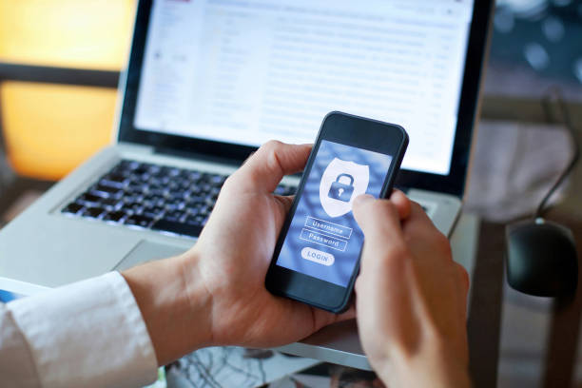
ADDITIONAL TIP: Emergency Lockdown Mode
• iPhone users have an optional, emergency Lockdown Mode to protect against sophisticated and targeted cyberattacks. • Lockdown Mode limits the functionalities of certain apps, websites and features to reduce the likelihood that spyware can break through to access data stored on devices.

Slide 15
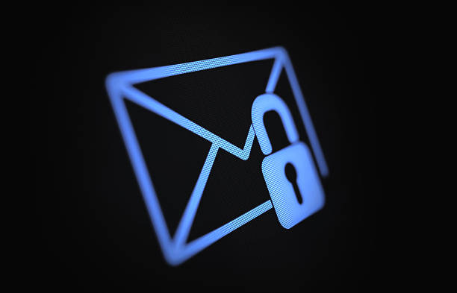
Email Security
Securing your email is essential to protect your personal information, prevent identity theft, and avoid falling victim to scams or cyberattacks. Here’s a practical guide to keeping your email safe:

Slide 16
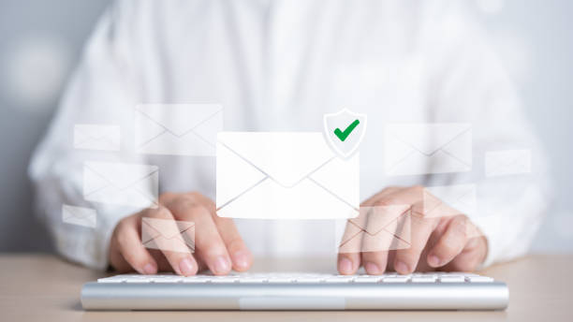
Create strong passwords and enable multifactor authentication
Strong passwords
Strong passwords provide the foundation of digital protection. Their strength allows them to withstand the many attacks that target passwords, including phishing operations, keyloggers and other attacks aimed at intercepting data or gaining unauthorized entry to protected accounts or data.4 The best defense against these attacks is to prevent them by creating strong passwords and regularly changing them.

Slide 17
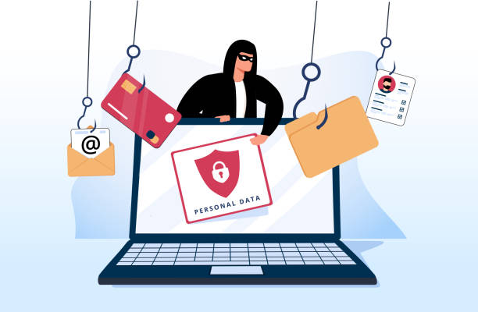
A STRONG PASSWORD IS:
1. Long 2. Complex Avoid using numbers or letters in a sequential manner or using personal or family information. Avoid using birthdates, names of family members or pets in passwords. 3. Random 4. Easy to remember Use more than 12 characters. The shorter it is, the quicker it can be identified. Use uppercase and lowercase letters, numbers and symbols. Forgetting passwords begins a cycle of retrieval, which requires more information. Use a password manager (below) if remembering multiple passwords becomes complicated.

Slide 18
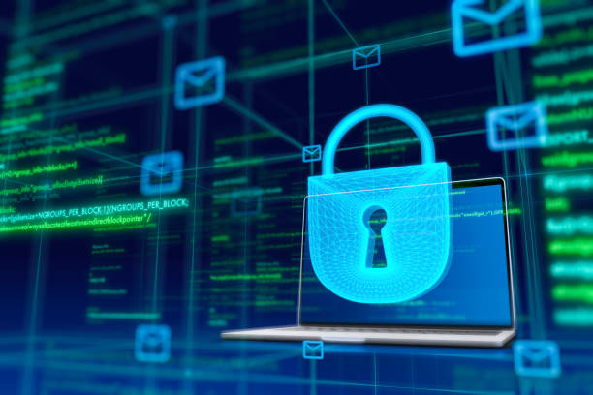
5. Confidential Create and save passwords but only in safe places. Unsafe places include directly in the browser, a phone’s notes application, a phone’s reminders application, sticky notes on a computer or inside a notebook/agenda. These locations are insecure because they are easy to access. 6. Unique Each account or service must have its own password. Discovering the password for one account will make other accounts vulnerable if they use the same password.
7. Periodically changed Create and save passwords but only in safe places. Unsafe places include directly in the browser, a phone’s notes application, a phone’s reminders application, sticky notes on a computer or inside a notebook/agenda. These locations are insecure because they are easy to access. 8. Original Do not use common keyboard patterns, e.g., “Qwerty12345” or “Password123”.

Slide 19
Passwords can be saved in hard-to-reach caches or password managers. These caches are strong password generators and a huge number of passwords can be saved in them. Password managers considered safe at the time of publication include: 1. KeePassXC 2. Bitwarden

Slide 20
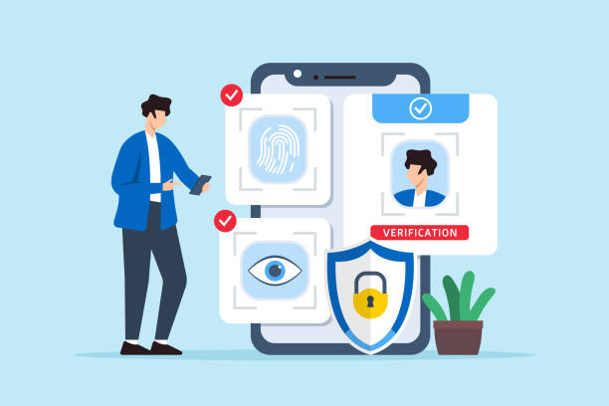
Multifactor authentication
Activating the multifactor authentication feature on accounts provides serious protection from hacking and phishing. Multifactor authentication is an additional feature that prompts users to enter a single-use passcode that is generated after they enter their regular password. This single-use password is sent to the user via SMS or email, or accessed via a specific authentication application. The best way to enable two-step verification is to do so by using an external app. The following applications were considered safe at the time of publication: 1. Duo Mobile 2. Aegis Authenticator (for Android only) 3. Google Authenticator (iOS or Android)

Slide 21
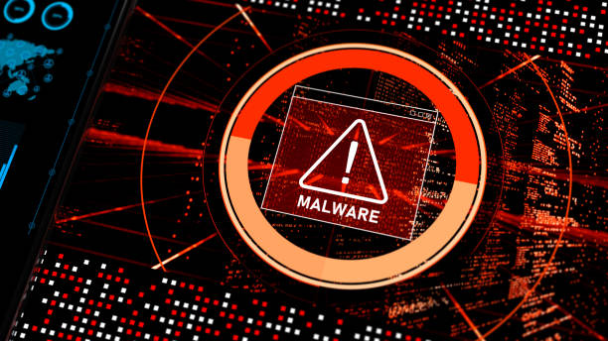
WHAT IS MALWARE?
Malicious software, or “malware”, is a term describing software designed with the intent to damage, exploit or disable devices, operating systems or networks. It is used to steal data, gain unauthorized access, disable some or all functions, or damage devices or any related networks. “Viruses” make up only a small part of the malicious software family. Other types of even more harmful malware may infiltrate and infect devices during Internet use. The process of eliminating malware requires ongoing preventive steps. Creating barriers to infection and penetration by malicious software allows users to eliminate threats before they enter their devices. There are many types of malicious software, including Trojans, worms, ransomware, adware, spyware and others

Slide 22
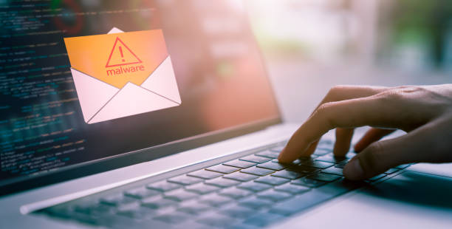
How to protect devices from malware
1. Install reliable EDR software on every device running Windows, Mac, Linux, iOS or Android systems, including all computers and mobile phones. Note that only one EDR programme should be installed. 2. Only download programmes and applications from their official websites. 3. Regularly update each device’s operating systems and applications. 4. Avoid using public and/or unsecured Wi-Fi networks without proper protection (such as a VPN). 5. Do not click on links from strangers or suspicious emails or messages even from known contacts. 6. Avoid sharing personal information.

Slide 23
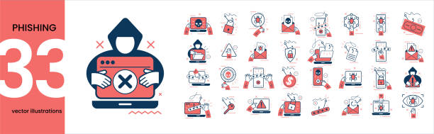
7. Use a safe Internet browser. 8. Install recommended security add-ons for the browser. Two EDR programmes considered safe at the time of publication (both free and paid versions) are Malwarebytes and Avira. Note that free anti-virus software offers basic protection against common viruses whereas paid anti-virus software offers more advanced protection

Slide 24

Online Browsing Security
Risks to users begin when a computer or phone connects to the Internet and a user starts searching or communicating with others. To increase safety, use secure tools to access the Internet. This helps prevent service providers, authorities or hackers from monitoring users’ activity

Slide 25
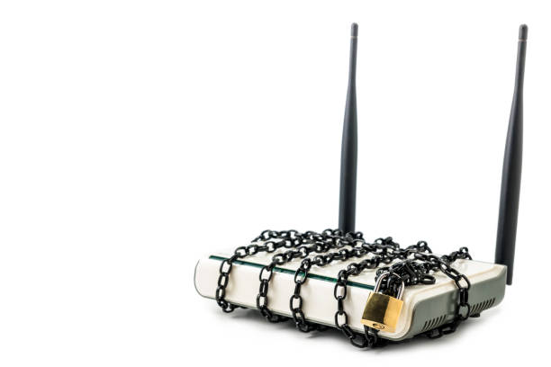
Securing your router
Step one involves securing the Wi-Fi hotspot at home or at work by changing the router settings. Request technical assistance for these steps if they are unfamiliar. For basic information about how to configure a router, please see Protecting Against Malware: Secure Your Router. 1. Change the username and password of the router administrator account. 2. Change the IP address of the router. 3. Use a strong and private password for the Wi-Fi. 4. Set encryption settings and choose WPA2-PSK (AES). 5. Update the firmware of the router. 6. Hide the name of the Wi-Fi network

Slide 26
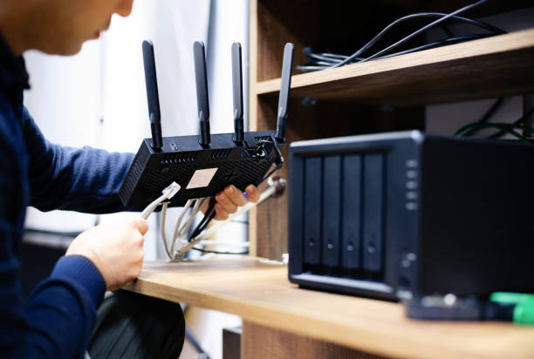
Using public Wi-Fi hotspots
Public Wi-Fi networks (in cafes, stores, malls, hotels, airports, public transportation, restaurants, etc.) are usually weak in security and can pose serious threats, including: 1. Threat of packet discovery: Attackers (hackers) monitor and intercept unencrypted sent or received data transmitted over unprotected networks. 2. Man-in-the-middle attacks: Attackers infiltrate the weak Wi-Fi hotspot to be part of the communication between the target victim and the hotspot, to intercept and sometimes modify data in transit. 3. Deceptive Wi-Fi networks: Attackers create and set up a free and open hotspot for the public to connect, making it a corridor to collect user data

Slide 27
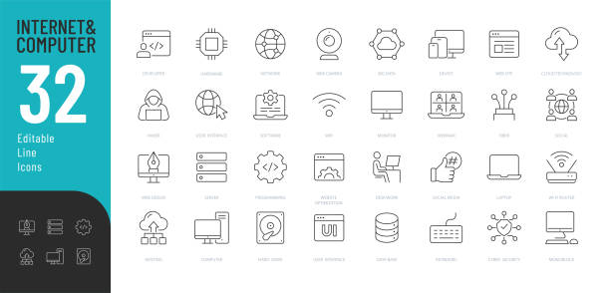
Protect yourself when using public Wi-Fi
If possible, use a portable or mobile hotspot rather than public Wi-Fi. Follow these guidelines to protect personal information from attackers while using public communication points: • Avoid using unknown/insecure hotspots or public Internet whenever possible. • If using a public network, be sure to enable multifactor authentication for all accounts before use Use a firewall. Most operating systems include this service, as do anti-malware/EDR programmes. Applications considered safe at the time of application include:
1.Avira
2.Comodo
3.Glass wire
4.Kaspersky

Slide 28

Use a VPN service to encrypt Internet connections and keep online activity private on any network. VPNs considered safe at the time of publication include:
1. windscrib
2.ProtonVPN
3.Psiphone
Tunnelbear

Slide 29

Use safe browsers
Browsers are the main gateway to access the Internet and therefore play an important role in online security. It is necessary to choose a safe browser as protection from theft or data privacy violations. Browsers considered safe at the time of publication include:
1. Firfox
2.Brave
3.ghostery dawn
4.Duck duck go

Slide 30
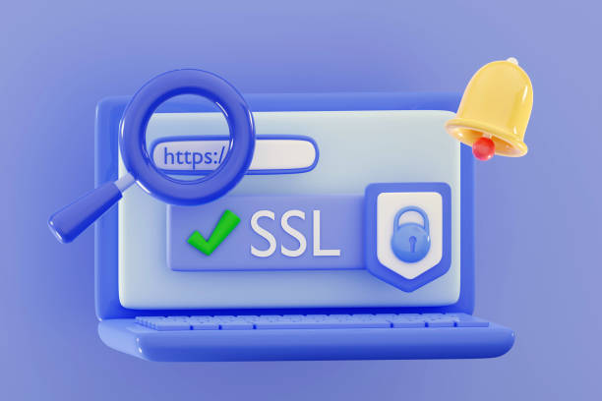
Use safe search engines
Conduct online searches with secure search engines that maintain privacy. Many common search engines, including Google, Bing, Amazon and Yandex, do not meet privacy standards. The following search engines provided more security and privacy at the time of publication:
1. Duck duck go
2.Qwant
3.Startpage

Slide 31
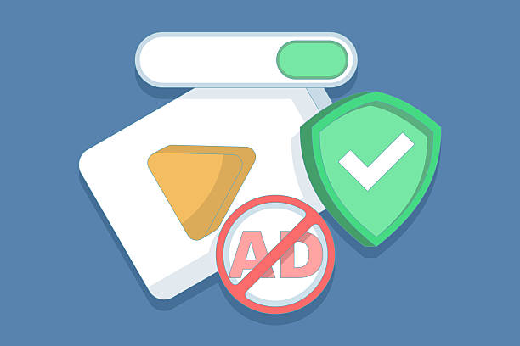
Use safe browser extensions/add-ons
Browser extensions, or “add-ons” extend the functionality of a programme on another programme, such as a browser. Add-ons are usually not full versions of software but rather are pieces of code that modify a specific interface. The most common add-ons for browsers are toolbars that provide users with instant shortcuts to online services. The only add-ons or browser extensions that should be downloaded are those that increase the user’s security and privacy. At the time of publication, the following extensions provided users with enhanced security:
1. HTTPS everywhere
2.Virus total
3. Ghostery
4.Malwarebytes
5.NoScript

Slide 32
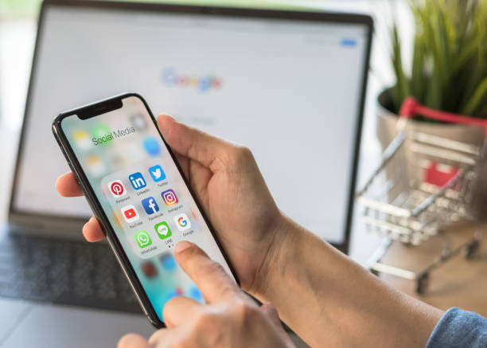

Social Media Security Encryption
In basic terms, encryption is the process of transforming data from a readable format into a secret code that can only be “unlocked” by users who hold the secret “key” or password.

Slide 33
Benefits of encryption
Helps organizations secure offices
Protects data during transfer to cloud storage
Protects intellectual property
Helps maintain data integration and privacy
Helps organizations comply with privacy and security regulations
Protects data as they are transmitted across devices

Slide 34

ENCRYPTION CAN BE USED TO:
Save photos, videos and data to devices
Share files and documents
Send emails privately
Store files using cloud services
Communicate via messages or calls

Slide 35
What is “secure communications”?
Secure communications entails encrypting a user’s communications using one or more security protocols to ensure that data flows between a sender and recipient without reaching a third party. Encryption scrambles plain text into Online Protection and Digital Security: User guide for human rights defenders 17 a type of secret code that others cannot read, even if they intercept it before it reaches its intended recipients. When the message reaches its recipients, their device uses its own key to unscramble the information back into plain, readable text. If the connection is not encrypted, governments, groups and individuals with technical backgrounds can listen to or read communications; access, intercept and modify content; plant malware; and open backdoors within the system to transfer data to and from the device.

Slide 36
Security standards
The following criteria are recommended for choosing communications programmes and applications to prevent eavesdropping, spying and unauthorized access to personal information. • Communications should be encrypted between the sender and the recipient, using end-to-end encryption (E2EE), so that even the company or service provider cannot access the content of messages. Messages issued by the sender are encrypted and not decrypted until they reach the recipient’s device. • No tracking, meaning that the company that produced the application does not track contact information or collect user data. Most commercial companies collect information about the user and sell it to other companies or countries, such as advertising and marketing companies.

Slide 37
The application or programme should be open source, as discussed above. Open-source software provides the code for applications and programmes to technicians for evaluation and detection of weaknesses. Open-source code also allows a review of whether the producing company collects user information and data. It is best to use programmes with a strong track record and to clearly understand security programmes and privacy policies. • An anonymity feature should be available, meaning that the programme or application can hide the user’s personal information (name, phone number, email, geographic location and device ID) even while sending and receiving messages, voice calls and attachments (including .doc, .pdf, .jpeg, .mp3, etc.)
Many users wonder if common applications, including Facebook Messenger, Viber, Telegram, WhatsApp and others, meet the above criteria. A review of the transparency reports that companies periodically produce and evaluations by security technicians indicates that, unfortunately, these applications adhere to some of the above standards but often do not meet all of them.

Slide 38

Recommendations for secure communications applications
Signal
The following criteria are recommended for choosing communications programmes and applications to prevent eavesdropping, spying and unauthorized access to personal information. Signal Private Messenger is widely considered one of the safest applications for maintaining privacy and adheres to all aforementioned criteria with one exception: anonymity. Signal requires a phone number to activate it; however, it does not track information or collect user information.
Wire This application meets the above standards, with an easy user interface. It is available for phones and computers. It does not need to be installed as a programme or application – it can be used within a browser as an extension.

Slide 39
JITSI
JITSI MEET is a platform for communicating or holding online meetings. Its advantage over other web-based meeting programmes is that it creates an encrypted channel for communications and maintains anonymity. It is not necessary to create an account or enter any personal details. Users may visit the website via a browser, open a chat and share the link with anyone they want to invite to the conversation. The Jitsi application may be installed on computers and mobile phones.
TRESORIT
This service also encrypts information from end-to-end. It has a simple interface and maintains the security of information, encrypting it during transmission.

Slide 40
How to send secure (encrypted) emails with PGP
The following criteria are recommended for choosing communications programmes and applications to prevent eavesdropping, spying and unauthorized access to personal information. The best way to ensure emails are secure is to encrypt them with “PGP”, which stands for “pretty good privacy”. This is an encryption system used for both sending encrypted emails and encrypting sensitive files. PGP encrypts emails and their attachments to increase the confidentiality of communication by generating a pair of private and public keys needed to “open” the information

Slide 41
NOTE:
PGP is only useable when both the sender and recipient use applications or programmes intended for encrypting and decrypting messages. Many programmes and applications use the OpenPGP standard, so each user does not need to have exactly the same programme; however, they must be equipped to “exchange keys”. Communicate with contacts about the best way to establish secure communications before attempting to send encrypted emails.
Mailvelope is a recommended programme that can be used with popular webmail providers such as Hotmail, Outlook, Gmail and Yahoo. It can be added as an extension to browsers including Google Chrome and Firefox. It generates the necessary public and private key pair, then shares the public key with other users for them to add it.

Slide 42

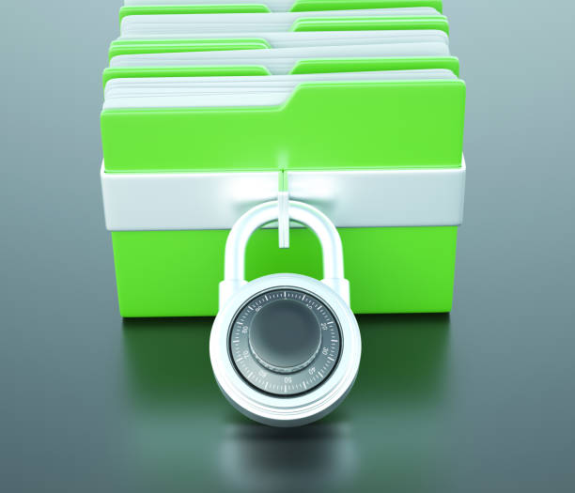
Save and store information securely
Users should both encrypt information they share with others and encrypt their own information to securely store it. This section provides a guide to the different ways encryption can be used to store data on a user’s devices and in the cloud.

Slide 43
Saving photos, videos and data to a device
Tella is an example of an application that helps keep data more secure. It is used by activists, human rights defenders, civil society organizations, media and specialists in humanitarian work and documentation. It is currently only available for Android devices but an iOS version is in development. Tresorit PGP is only useable when both the sender and recipient use applications or programmes intended for encrypting and decrypting messages. Many programmes and applications use the OpenPGP standard, so each user does not need to have exactly the same programme; however, they must be equipped to “exchange keys”. Communicate with contacts about the best way to establish secure communications before attempting to send encrypted emails.

Slide 44
Note: Online Protection and Digital Security: User guide for human rights defenders 19 • It is easy to use, with a simple interface. • Users lock the application via the “pattern method” by creating a shape. • Users can change the application icon so it cannot be recognized. • It has a “quick delete” feature to erase data in case the user faces the danger that his or her phone may be seized. • The application itself can be permanently deleted in cases of immediate danger.

Slide 45
Encrypting and storing files using cloud services
Although many people save and store their sensitive files on their computers or in external hard drives (without encrypting them), this tactic is risky. If unauthorized access occurs, these devices can be taken over and decrypted or individuals could force the user to open the encryption. It is very important not to leave sensitive information on devices, as this can put the user at risk both online and offline. Storing information securely in the cloud ensures that unauthorized third parties cannot access sensitive information. Users should avoid leaving traces of data on devices that could cause security problems.

Slide 46
“Cloud services” are infrastructure platforms or software hosted by third-party providers made available to users through the Internet. The following secure cloud services are recommended for storing sensitive information without leaving physical traces: • Google Drive • pCloud It is still important to encrypt data before uploading it to the cloud.

Slide 47
Encryption software
At the time of publication, VeraCrypt is a secure open-source programme that encrypts data and saves files on the user’s computer. Only the user can view the data by using a key to decrypt it. VeraCrypt can encrypt data, files and folders, but it can also encrypt entire external volumes such as USB flash drives, hard drives or parts of hard drives. It can be used on Windows, Mac and Linux.

Slide 48

Erase data securely
When a user “deletes” data from a computer, smartphone, digital camera or other device, the data are not actually destroyed. Deletion simply “hides” the data from the user but does not erase them from the device. This section describes how to securely and permanently erase data, and covers the basic terms associated with security scanning, how the process is conducted, and what safe programmes and applications can be used to erase information so that it cannot be recovered. It is important to understand the differences among key terms:

Slide 49
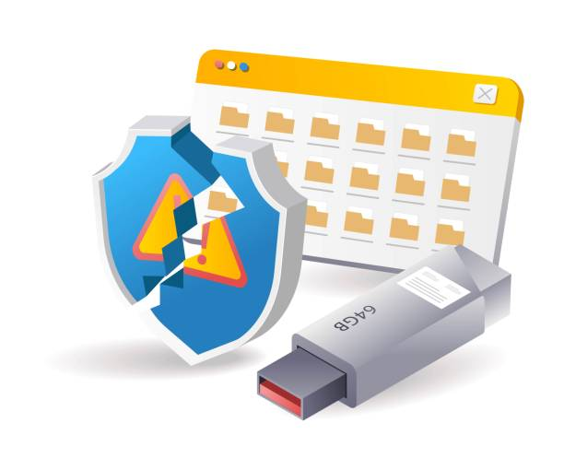
Deleting Erasing Wiping Shredding When something is “deleted” from a device, it is simply “hidden”. It is not removed from existence – it can be recovered.
“Hide me, but I’ll be here if you really need to recover me.”
Erasing
Erasing data means it is “missing” from the operating system. Before erasure, users often receive advance warnings stating that the data cannot be recovered. Since the operating system cannot see the data, the drive is empty when its contents are reviewed. Data may be erased by “wiping” or “shredding”. “Are you sure? You’ll NEVER see me again!”

Slide 50


Wiping When a hard drive or storage device is “wiped”, everything contained on it is erased, including anything a user previously deleted that could still be recovered. “I’m going to erase EVERYTHING.”
Shredding When a piece of data (usually one or more files or folders) is “shredded”, only the specifically selected item(s) are erased and nothing else. “I’m going to erase this and only this.” “Are you sure? You’ll NEVER see me again!”

Slide 51
Question
Does deleting files from the desktop and emptying the recycle bin mean that files are permanently and irreversibly removed from the computer or smartphone? YES NO

Slide 52
Answer
No. Deleting data and emptying the recycling bin marks the space as “available”, but until the “available space” is written over with new information, the underlying data can still be recovered.

Slide 53
Question
Does reformatting a hard drive permanently and irreversibly remove data?
Yes NO

Slide 54
Answer
No. Reformatting is a great way to “delete” data – not “erase” it! The reformatting process marks all space on the device as “available”; however, underlying data can still be recovered until it is written over with new information. This is an acceptable process if the same user is planning to reuse the drive but it does not automatically eliminate sensitive information.
Techniques for recovering deleted files are improving every day, and many types of supposedly “deleted” files (photos, documents, videos, etc.) can be recovered. Disk wiping or shredding ensures that the “available” space created by simple deletion is overwritten, rendering the underlying data unrecoverable.

Slide 55
How to clean devices
To clean a (Windows) computer (delete temporary files and clean up system files), use the system’s Disk Cleanup tool as follows: • Go to the Start Menu, then All Programmes, then System Tools, and then select Disk Cleanup (or type Disk Cleanup in the search box, which will open the application).

Slide 56
How to permanently erase or wipe data
One of the most important parts of data wiping involves wiping underlying layers of information and overwriting them with new data. This permanently prevents the possibility of recovery. • Eraser is a security tool for Windows that completely removes sensitive data from your hard drive. • BCWipe is a programme for erasing and wiping information. If you are disposing of your computer system, it is recommended that you remove the hard drive and RAM and destroy them separately and securely as they can contain data.

Slide 57
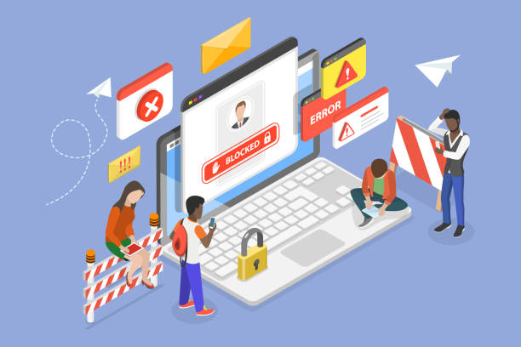
Fake Pages, Fake Emails and Messages
“Phishing”, also called electronic fraud, electronic solicitation and electronic theft, is a collection of tactics and techniques used to steal or obtain personal information, passwords, business information, financial accounts, etc.. Phishing is one of the most common ways to target users. Preventing phishing is one of the easiest ways for users to protect themselves from becoming a victim.

Slide 58

In simple terms, an attacker exploits a user through a deceptive process or uses social engineering techniques to encourage or force the victim to respond to the attacker’s request. The request usually involves convincing a user to: • Click a link • Share information • Give permissions • Download files infected with malicious software An attacker usually waits for the target to make a mistake, and then can obtain the victim’s information and access his or her accounts.

Slide 59
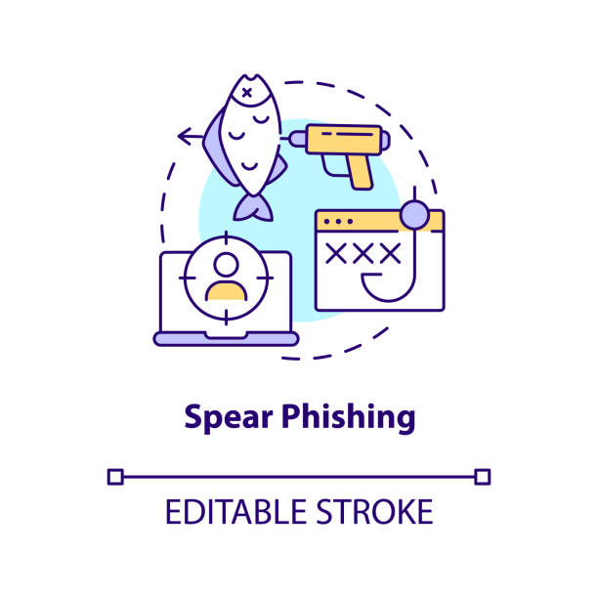

Types of phishing
Spaer Phising
A sophisticated technique that targets a specific person or a group. The attacker collects information about the victim and then uses it to formulate a message that appears to be real. This kind of phishing is generally conducted through emails targeting the victim
Whealing
Spear phishing technique targeting especially influential and powerful people within companies or organizations.

Slide 60
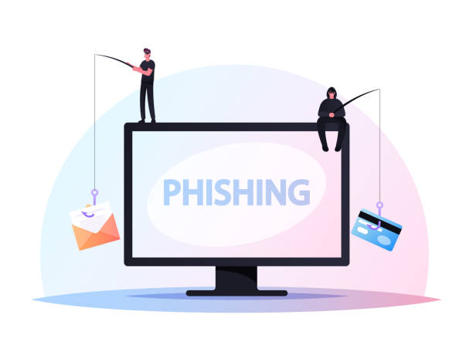
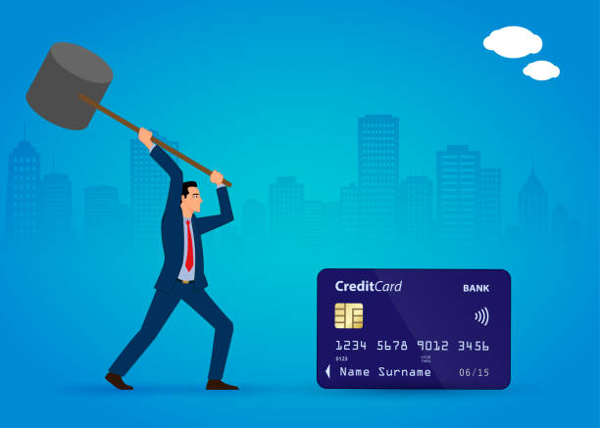
Phrming
A type of fraud in which the attacker directs the victim from a main/reputable site to another fake site or a site compromised with malicious software. A victim’s information can be intercepted when they enter the site.
Smishing
The use of SMS text messages to defraud the victim by prompting him or her to disclose information about accounts, obtain multifactor authentication numbers or download malicious software into the victim’s device

Slide 61
Search engine phishing The attacker creates a website on the Internet, puts it on search engines or social media, and offers goods at cheap prices, luring the victim to pay for a product. The victim then enters his or her bank account information, which is stolen and used
Voice phishing The attacker uses a voice phone call to trick the victim into believing that the caller is from an official body in order to obtain information from the victim

Slide 62
How to protect yourself from digital phishing
All users should be extremely careful and follow these tips:
Never share sensitive or personal information with others, and never publish it on social media under any circumstances.
Do not respond under any circumstances to threats received via messages, emails or social networking sites. Do not interact in any way with those making threats.
Do not open links received, even from close contacts, without checking them first. a. Use Virus Total to check links and files. Do not click links immediately upon receipt – copy the link, open the website, paste the link into the URL Links window, and click Enter. If the result is 0, the link is malware-free. Do not click the link directly – copy and paste it into the browser. If the link is a normal content link, the content will appear in the browser.

Slide 63
Ensure the sites you access have a security certificate and that the link starts with “https://”. A padlock icon next to the URL in the browser’s address bar means that SSL (secure sockets layer) protects the website a user is visiting. SSL keeps Internet connections secure and prevents unauthorized users from reading or modifying information transferred between two systems.
Check the address or phone number of emails and SMS messages. Often attackers will disguise addresses to make them look similar to reputable contacts, but on closer inspection they do not match the website or person they are pretending to be.

Slide 64
All services you have subscribed to know your name, and their communications to you will include your name. Any message addressed “to our dear subscriber”, “kind customer” or similar phrases may be a fraudulent message: Take care in handling it.
Any gift or prize you receive is fraudulent if you have not participated in a competition or contest. Do not engage.
If you receive an email or other communications requesting sensitive information, contact the sender directly via a different method to inquire about the message.
Protect devices with Internet security and anti-malware programmes, and do not install “cracked” or pirated software.
Enable two-step verification on all accounts

Slide 65
Social Engineering
Adware: A type of software application that displays adverts of some kind while it is running. Sometimes developers will offer a “free” version of their software on the condition that you have to view adverts; they get paid by the number of people clicking on the ads. Quite often, there is also a paid version of the same software that is advert-free. • Cache: A temporary storage area where frequently accessed data can be stored for rapid access. • Cracked software: A “crack” or a “patch” is a programme designed to activate, register or extend the trial period of a proprietary programme that normally requires a serial number to prevent piracy and unauthorized use. Using a “crack” or “patch” to access software programmes is always illegal.5 • Encryption technology: Enables the user to shield data saved on USB drives, mobile devices, flash disks, pen drives, CDs or hard disks. An encrypted document cannot be read or viewed by unintended recipients, even if they have possession of the document itself

Slide 66
End-to-end encryption (E2EE): The application of encryption to communications tools and services, such that only the users of the tool or service have access to plain-text messages. Many forms of encryption are deployed by service providers to secure communications in a way that prevents unauthorized third-party access, but the service provider implementing it still has access to the relevant user data.
• Firewall: A firewall is a system designed to prevent unauthorized access to or from a private network. Firewalls can be implemented in hardware and software, or a combination of both.
IP address: A unique number that information-technology devices use to identify and communicate with each other on a computer network, based on the Internet Protocol (IP) standard. Any participating network device – e.g., routers, computers, printers, fax machines – must have its own unique address. It is the equivalent of a street address or a phone number for a computer or other network device on the Internet. Just as each street address and phone number uniquely identifies a building or telephone, an IP address can uniquely identify a specific computer or another device on a network.

Slide 67
Keylogger: A tool that records user activity, such as keystrokes, and that can send this information to an attacker using email or other methods. • Malicious software or “malware”: Software designed to infiltrate or damage a computer system without the owner’s informed consent. Software is considered malware based on the perceived intent of the creator rather than any particular features. It includes computer viruses, worms, trojan horses (trojans), spyware, dishonest adware and other malicious and unwanted software. The word “malware” is a combination of “malicious” and “software”. • Onion routing: The technological basis of the Tor network. The name is derived from the onion-like structure of the encryption scheme used, which is secured several times over many layers. The goal of onion routing is to use the Internet with as much privacy as possible, routing traffic through multiple servers and encrypting it at every step.

Slide 68
Open-source software: This is a generic term for software (applications and system software) where source code is openly available to any user. A programme can be used, copied, studied, modified and redistributed without restriction.
• PGP: This stands for “pretty good privacy”, an asymmetric public-key encryption software capable of ensuring the confidentiality and authenticity of electronic communications.
• Phishing: A tactic for committing online fraud and identity theft. For example, a “phisher” sends out an email that poses as a legitimate business request – for example, from a bank asking customers to verify financial data. The email includes a link that purports to go to a legitimate banking website. The site is bogus, however, and when the victim types in account numbers, passwords or other sensitive information, those data are captured and subsequently used by the phisher to commit fraud.

Slide 69
• Ransomware: A type of malicious software designed to block access to a computer system until a sum of money is paid. Some forms of ransomware encrypt files on the system’s hard drive (a.k.a. cryptoviral extortion), while others simply lock the system and display messages intended to coax the user into paying. • Spyware: Computer software that collects personal information about users without their informed consent. Personal information is secretly recorded with a variety of techniques, including logging keystrokes, recording an Internet web browsing history and scanning documents on the computer’s hard disk. • Trojan or Trojan horse: A programme that appears legitimate but performs some illicit activity when run. It may be used to locate password information or make the system more vulnerable to future entry or simply destroy the user’s stored software and data. A Trojan is similar to a virus, except that it does not replicate itself

Slide 70
• VPN: A “virtual private network” offers a controlled pathway through the Internet to which only authorized users have access and along which only authorized data can travel.
• Worms: A computer term referring to malicious parasitic programmes, similar to viruses, that replicate and spread across networks looking for vulnerable machines to infect. Unlike viruses, worms do not infect other computer programme files. Worms can create copies on the same computer, or can send copies to other computers via a network

Slide 71
Thank you So Much

